Slide 1

Network-based Intrusion Detection System (NIDS)
COMP.SEC.300-2024-2025
Joni Lehtonen

Slide 2
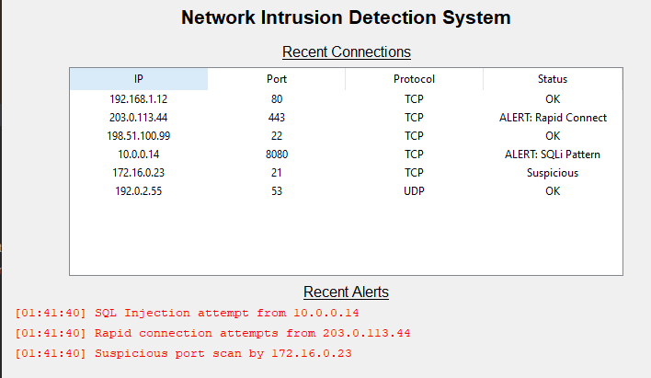
Features / AIM of the program
Captures & parses network packets.
Detects signatures from ”rules.txt”
Detects anomalies (flooding, SQLi patterns)
GUI displays alerts and active connections
Packet logging with integrity checks
Some optional features considered (IP geolocation for example)

Slide 3
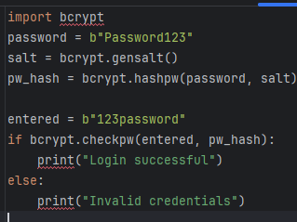
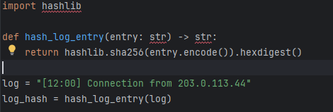
Secure Programming Practices (OWASP)
Passwords hashed with bcrypt
Logs hashed with SHA-256/HMAC
GUI login with rate-limiting to avoid brute-force
Detect SQL injection & alert
Detect insecure settings (e.g. default creds)

Slide 4
TEsting
Manual traffic injection using Scapy
Rules tested with known bad patterns (e.g. nmap, SQLi)
GUI tested for brute-force login attempts
Logging verified: hash check detects tampering
Simulated DoS traffic triggers rate-limiting & IP bans

Slide 5
Summary
Python-based NIDS + basic IPS and secure GUI
Scapy + Tkinter, bcrypt, hashlib used
Meets many OWASP Top 10 items
Extensible: add rules, alerts, and secure logging
Still needs works in the backend, GUI appearance
Will add online login if I have time, will add multiple features this way

